Slide 1
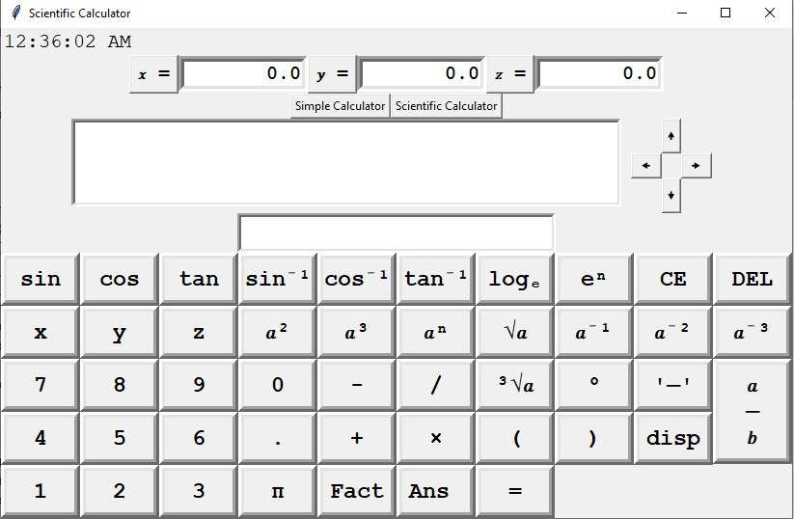
Scientific Fraculators

Slide 2


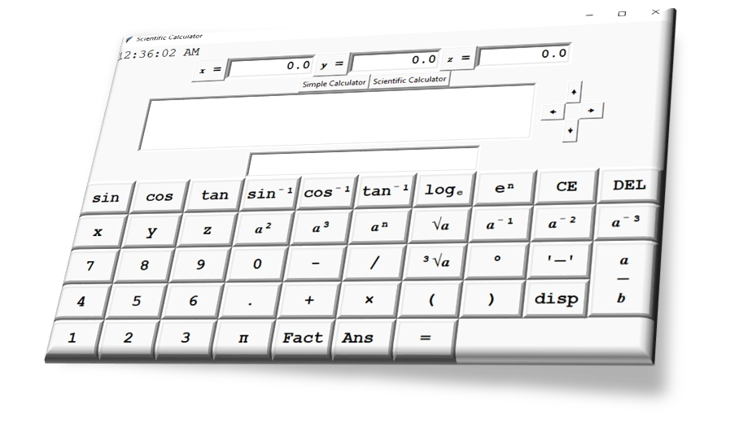
Important Features of Fraculator
Uses only basic libraries of tkinter, math and time.
Natural style input display for powers, and fraction.
You can also use your keyboard instead of clicking display buttons.
Navigation keys for input
Beautifully supports both degree and radian input of angles
A separate single line output display.
Supports three symbols for variables x,y and z

Slide 3
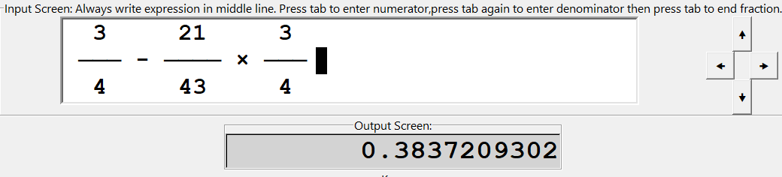
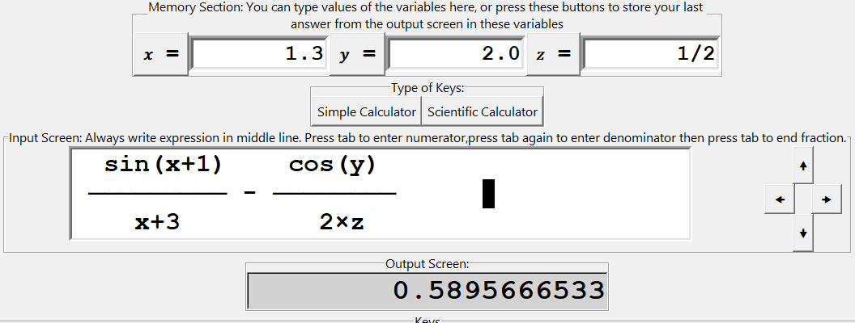
Uses tkinter, math, time and ctypes libraries
Simple calculations (addition, subtraction, multiplication, division)
Scientific functions (trigonometric, inverse trigonometric, logarithmic, exponentiation, factorials, square roots, cube roots, and more)
Fraction support
Use of variables (x, y, z) in calculations

Slide 4
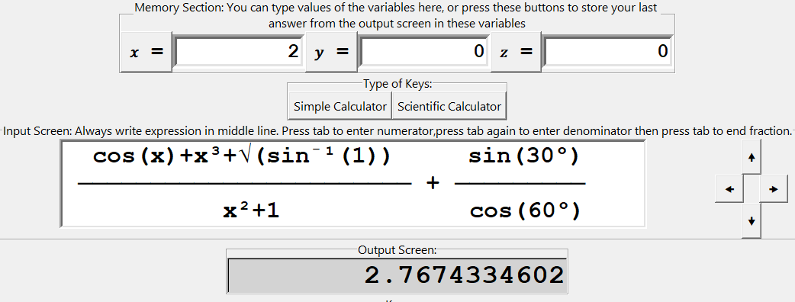
Pi constant support
Angle conversion (degrees, radians)
Navigation buttons for moving through the input screen.
Shortcuts for common actions (Enter, Tab, Escape)

